Slide 1
Section One: Intro and Overview

Slide 2
Overview
Expand Preparedness Report down to county level
  To increase emergency management capabilities across Indiana
  Uses guidance already available from FEMA in order to ensure the process is consistent across the state.

Slide 3
Reason
Tool to examine preparedness across the state
Justify grant funding
  Ensures limited resources are going to the most important areas
  Show return on investment
Tracks capability changes
Data has uses in areas outside preparedness

Slide 4
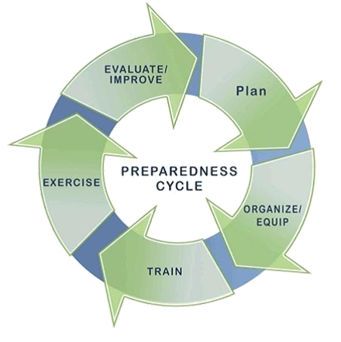
Goal
To expand preparedness reporting to the county level.
This will allow us to develop a high definition picture of the capabilities of Indiana as a whole

Slide 5
Benefits
Lets counties see themselves better
  Identify capability gaps and allows targeted efforts to close those gaps
Gives counties information to justify grant requests
Track year to year progress
  Show return on investment

Slide 6
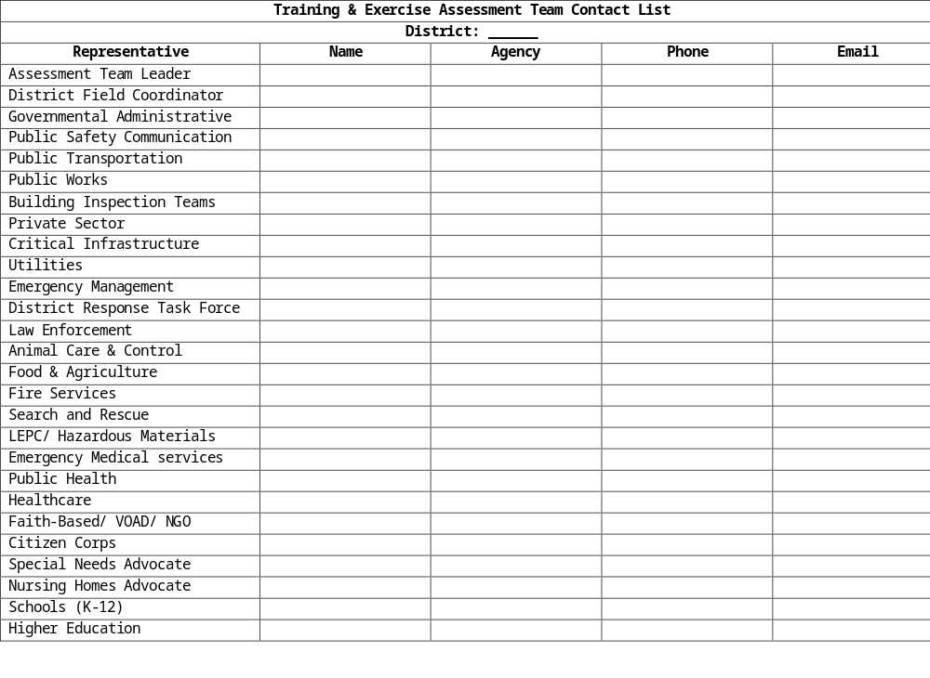

Slide 7
Our Rationale
To allocate the state’s limited funds to accommodate the county’s needs, based on seven out of the 31 FEMA guidelines of HIRA and capability of the POETE of each county.

Slide 8
Section Two: How It Works
(HIRA, RTIPP, Core Capability Assessment)

Slide 9
Hazard Identification and Risk Assessment (HIRA)
Identify hazards
-Natural, technological or human-caused hazards that apply to your jurisdiction
Give hazards context descriptions
-Outline conditions under which hazards might occur, include time and location
-Effective context descriptions should provide a sense of scale for the impacts of a hazard
Establish Capability Targets
-Describe impacts and desired outcomes
-Geographic area, number of households, fatalities, injuries/illness, infrastructure disruption
-Process
-Largest impact, desired outcomes, develop Capability Target
Resource requirements
-Apply capability targets to jurisdiction in order to identify recourse requirements
-Typing, inventorying, organizing, and tracking
-https://rtlt.ptaccenter.org/Public/Combined

Slide 10
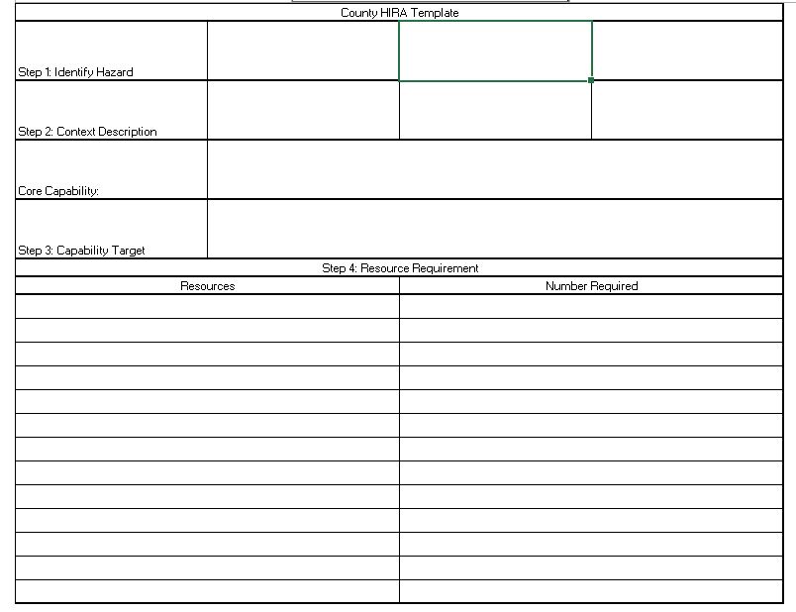

Slide 11
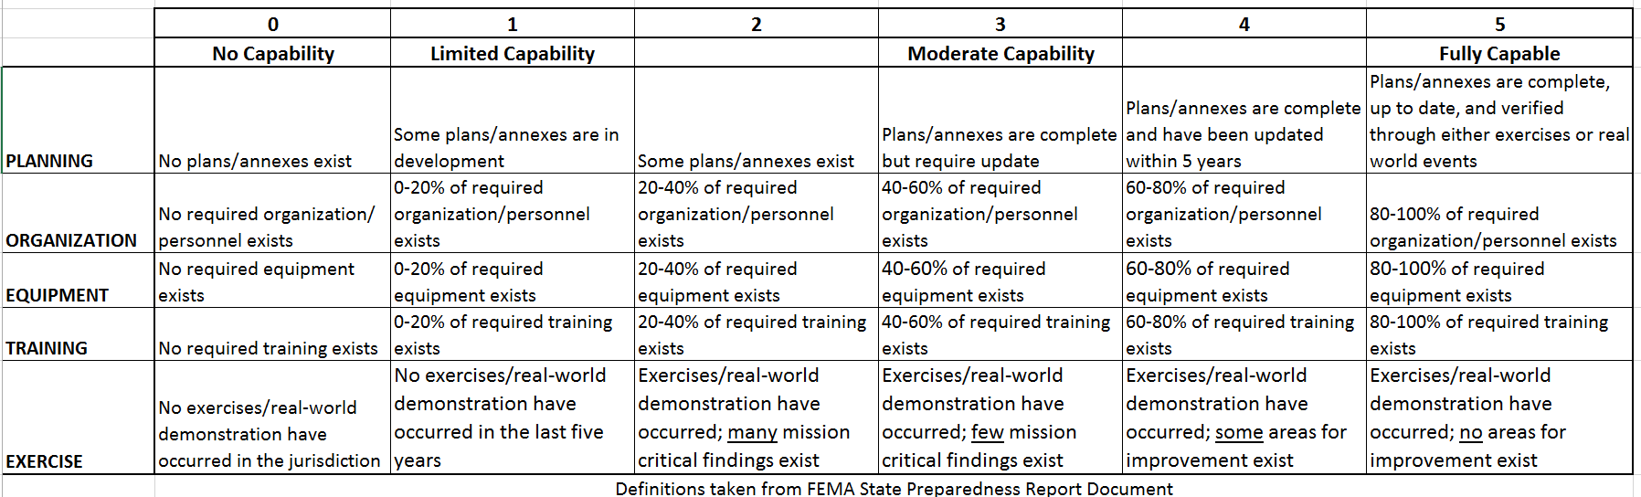
POETE

Slide 12
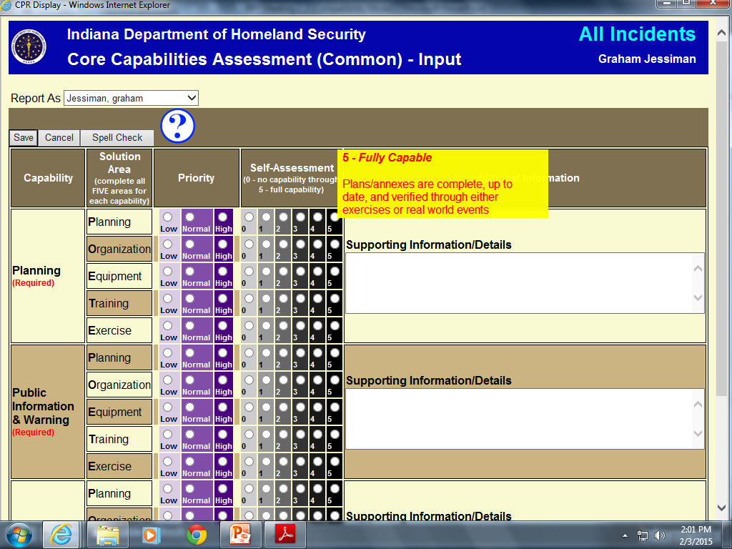
Core Capabilities Assessment
WebEOC based
Data shareable by default
  Opt out option
Exportable Report
Lock Data after submission

Slide 13
Emergency Management based Core Capabilities (Seven out of the 31 from FEMA):
Planning, public information and warning, operational coordination, intelligence and information sharing, situational assessment, threat and hazard identification, and operational communication
Solution Area, based on FIVE areas for each capability:
Planning, organization, equipment, training, and exercise (POETE)
Priority:
Priority determines what capabilities funds should be assigned to; ranking from low-to-high priority

Slide 14
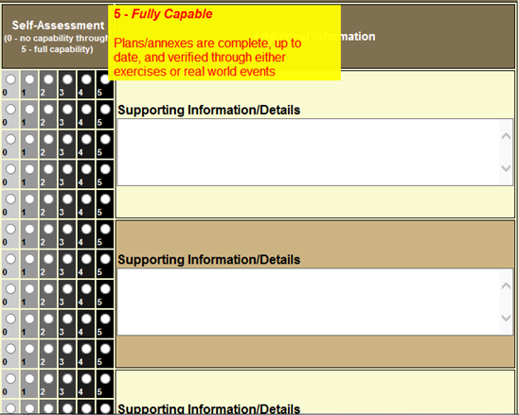
Self-Assessment:
Department heads from each county will be responsible for assessing the POETE criteria individually for each capability from Zero to Five; Zero meaning that there is no capability in an individual POETE criteria and Five meaning that an individual POETE criteria is fully capable in the county’s capability
Supporting Information:
This space gives county officials a chance to state why they feel they assess themselves this way; This section will be to help solidify why your county deserves funding in the desired capability

Slide 15
Readiness: Training Identification Preparedness Planning (RTIPP)
1.5 day training course
Preliminary meeting 8-10 weeks out
  -Several dates available
4 hours to include planning and exercise
Jurisdiction specific information (HIRA, Emergency Operations Planning [EOP], etc.)
Provides an opportunity to test current capabilities to better isolate areas for improvement and funding
Additional grant funds available for those who complete the course

Slide 16
How It All Works
HIRA and the Core Capability Assessment should take no more than a day’s time to complete
Several department heads should be present to complete these tasks; attendance should be recorded for verification
HIRA describes which hazards may impact their area and the Core Capability Assessment will provide an idea of their ability to prepare, mitigate and respond to hazards
Following HIRA and the Core Capability Assessment, it is strongly encouraged to register for an RTIPP exercise as soon as possible
RTIPP is recommended, but not required; Completing RTIPP will increase your chance for grant funding
RTIPP provides a plan to improve or sustain preparation, mitigation and response to capabilities listed in your assessment

Slide 17
Section Three:
Benefits & Negatives of the Core Capability Assessment

Slide 18
Why Do I Need This?
Increase emergency management opportunities across Indiana
Shows the strengths & weaknesses of each county
Expands preparedness to county-level
Already approved by FEMA

Slide 19
Why Do I Need This?
With completing this assessment, the county will show justification for federal DHS grants
Public Officials of the county will run this program, IDHS will not micro manage
Tracks progress from year to year
Can be used outside for preparedness

Slide 20
Disadvantages of the Assessment
May have multiple needs; Funds may go to one of your needs and not others
Counties may feel they are over-assessing
May not know enough to determine the needs of the county

Slide 21
Disadvantages of the Assessment
Counties may not see it as a necessity
False reporting of needs
May not have accurately reported the needs
Another function for public officials

Slide 22
Jesse Minnick
jminnick@dhs.in.gov

